Slide 1

Java Spring, Jenkins and Docker Project
Yuvraj Deshmukh

Slide 2
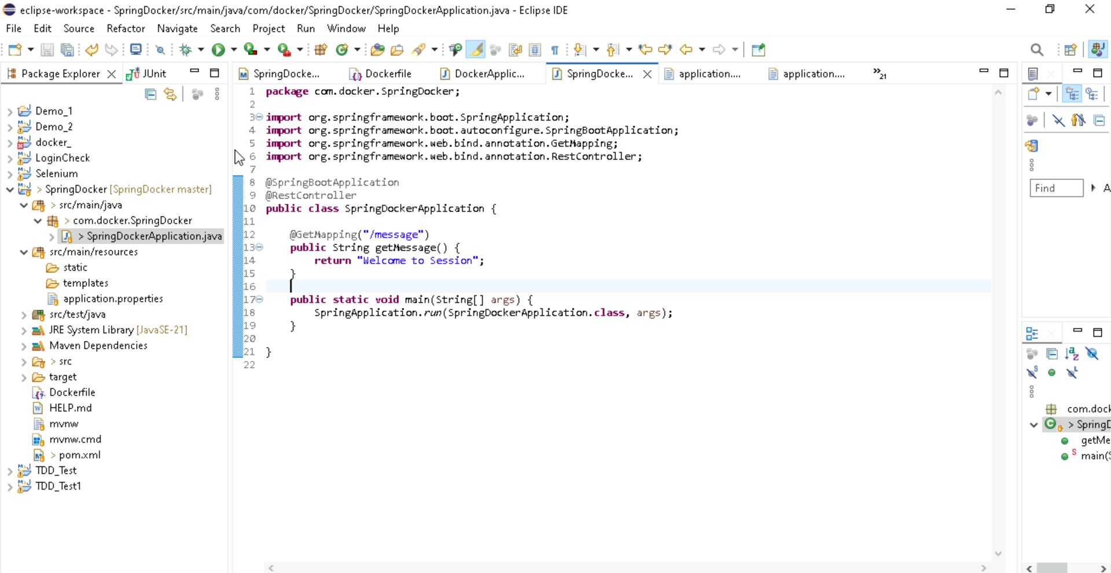
Code Understanding

Slide 3
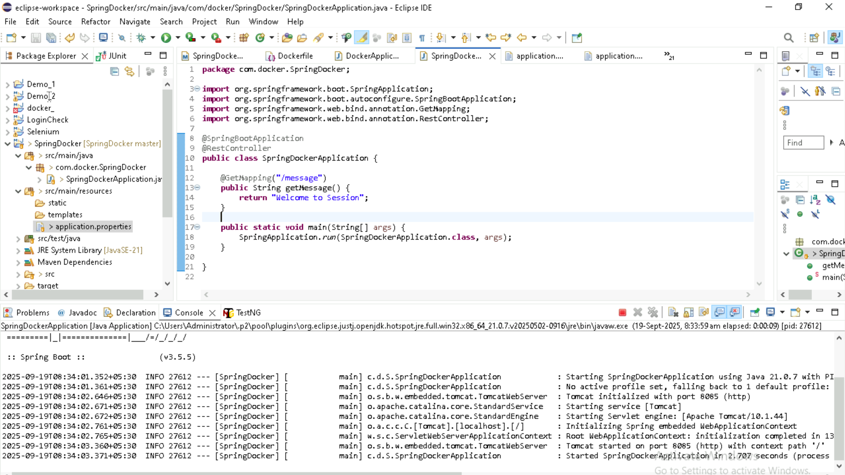
Code Understanding

Slide 4
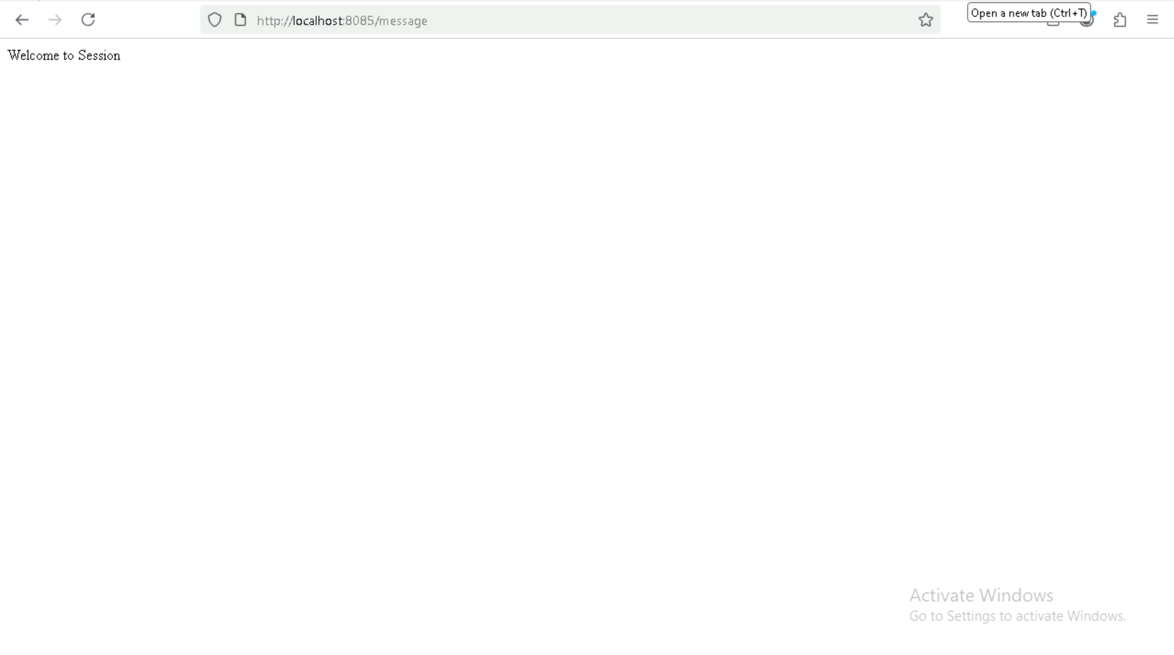
Code Understanding

Slide 5
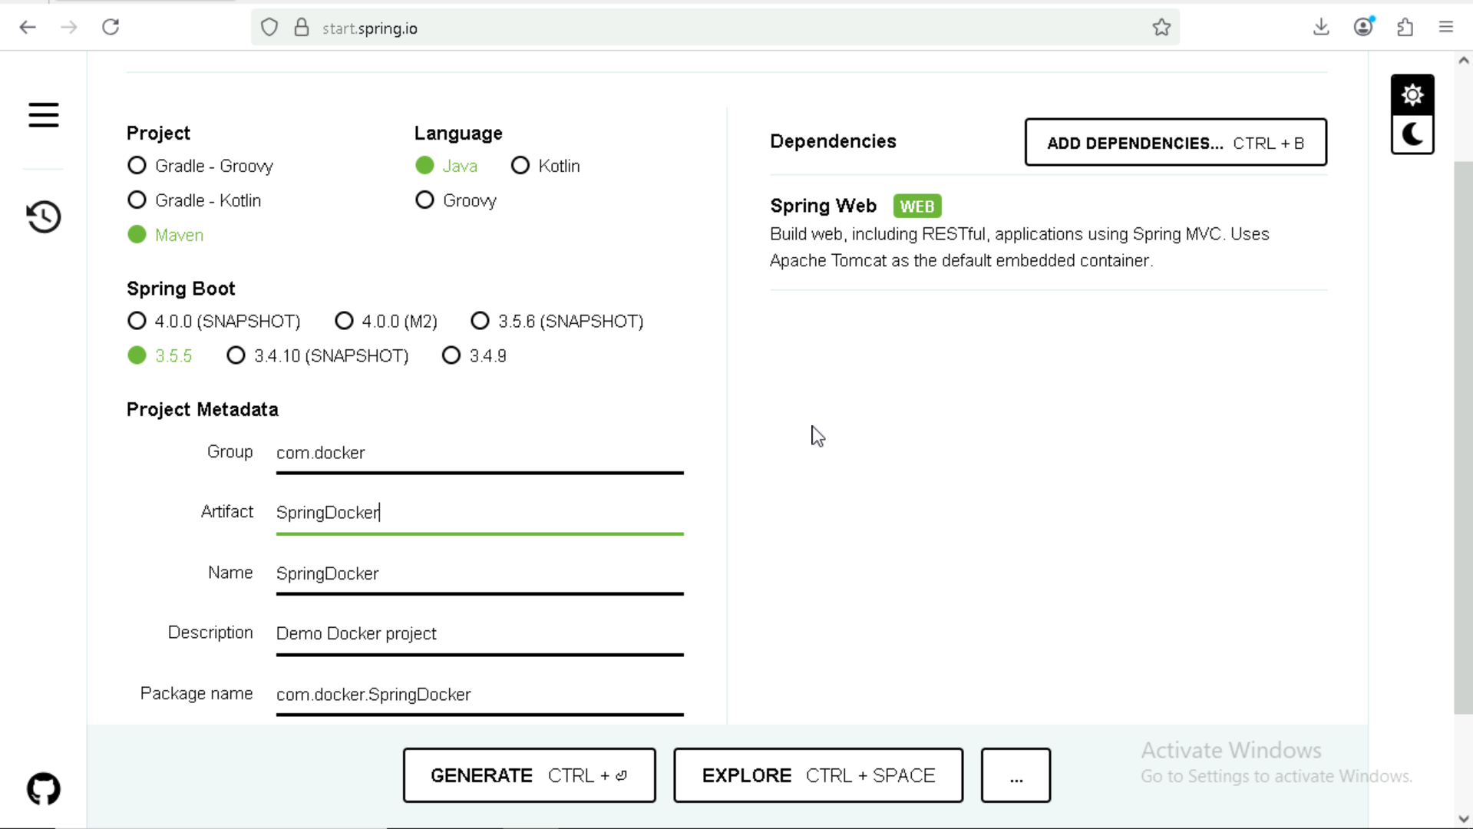
Project Creation
Create a Simple Spring Project from Spring Initilizer

Slide 6
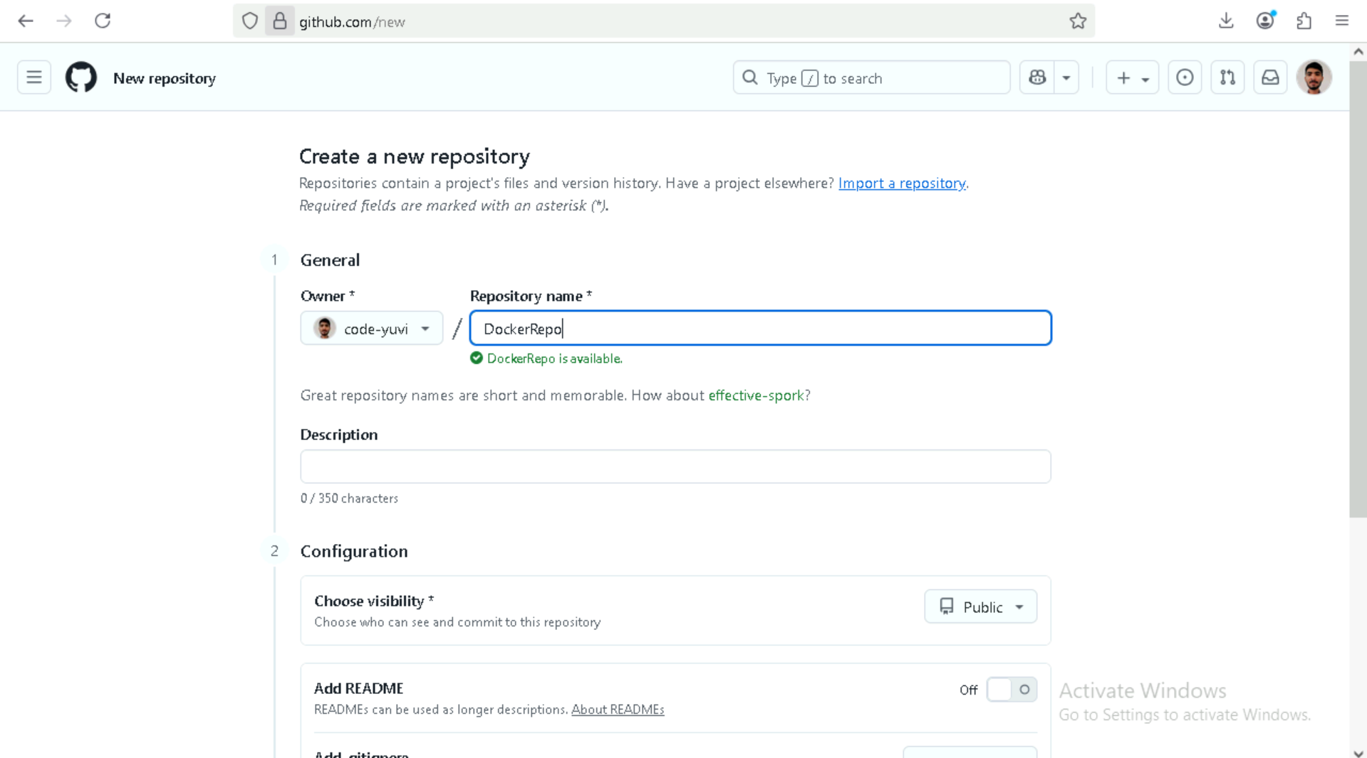
Create a GitHub Repository

Slide 7
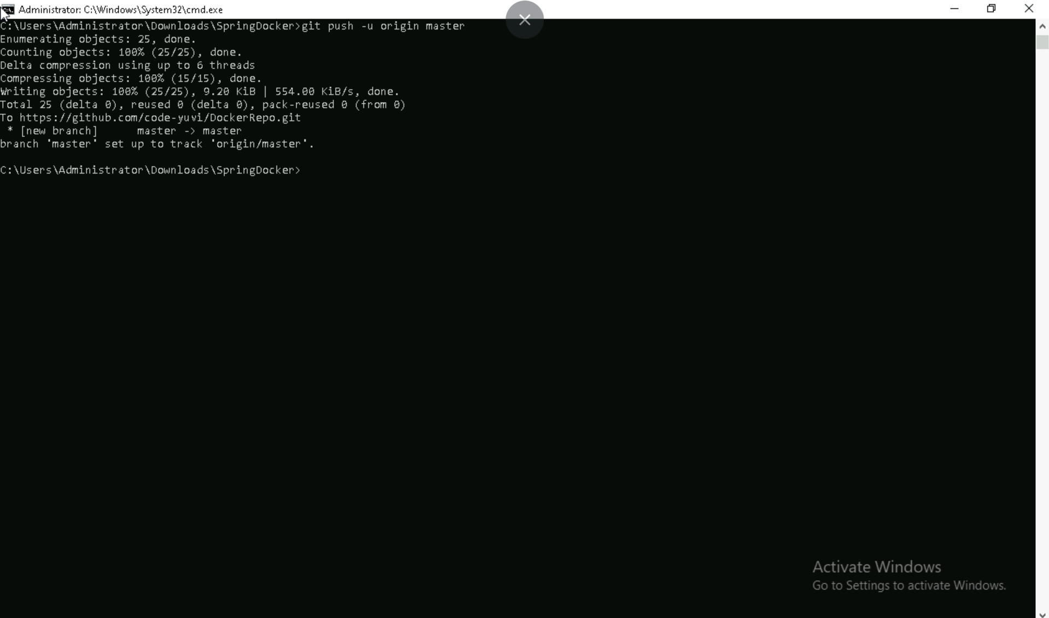
Push the project to git repo

Slide 8
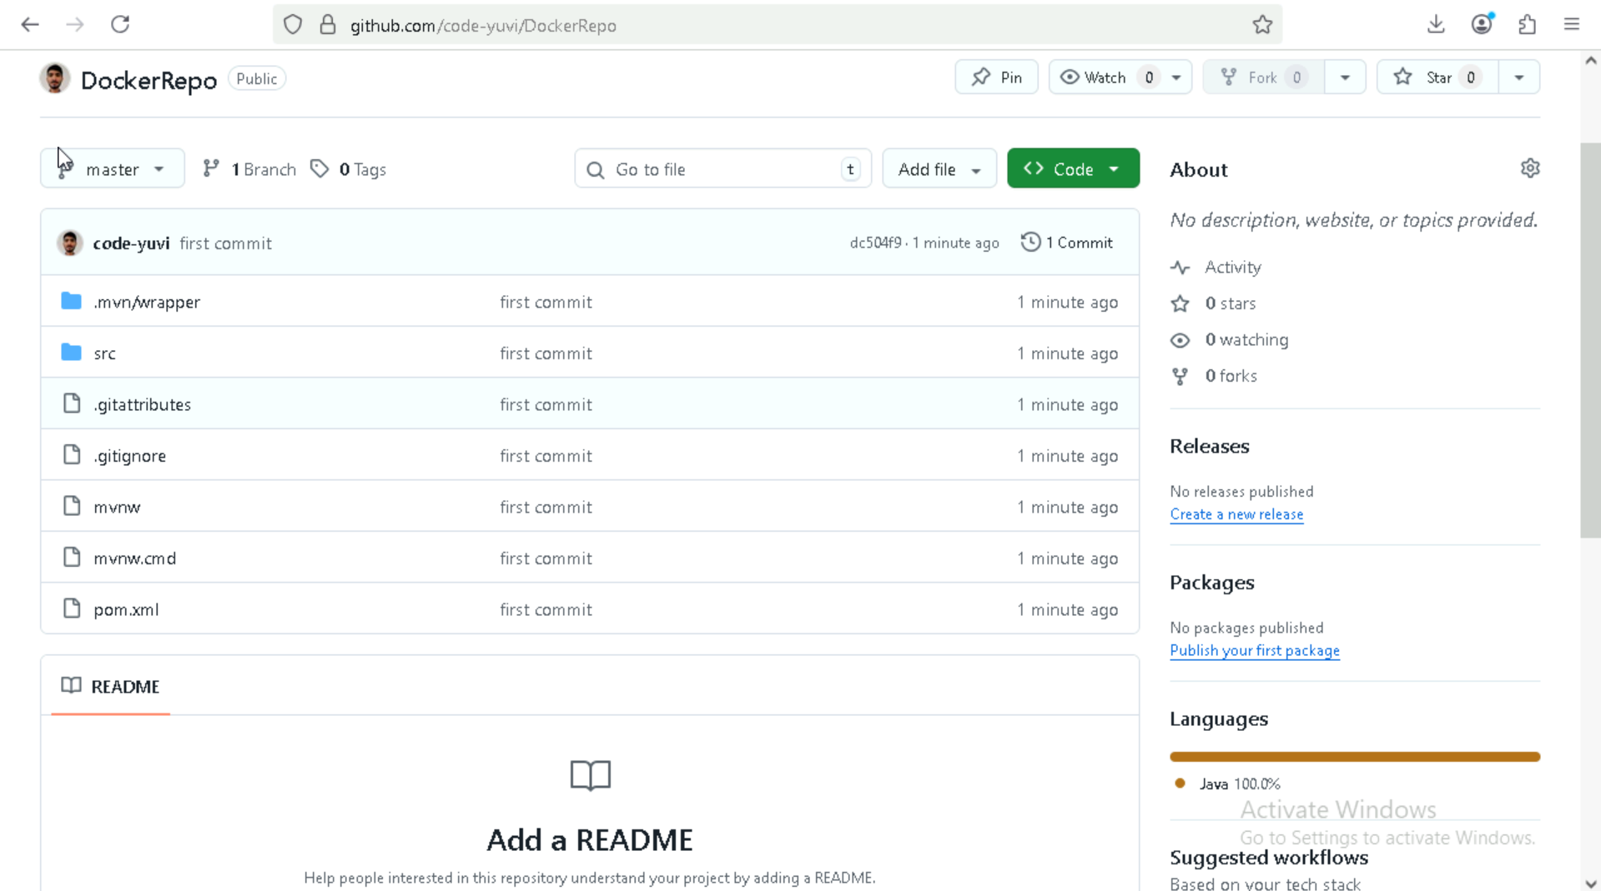
Project repo

Slide 9
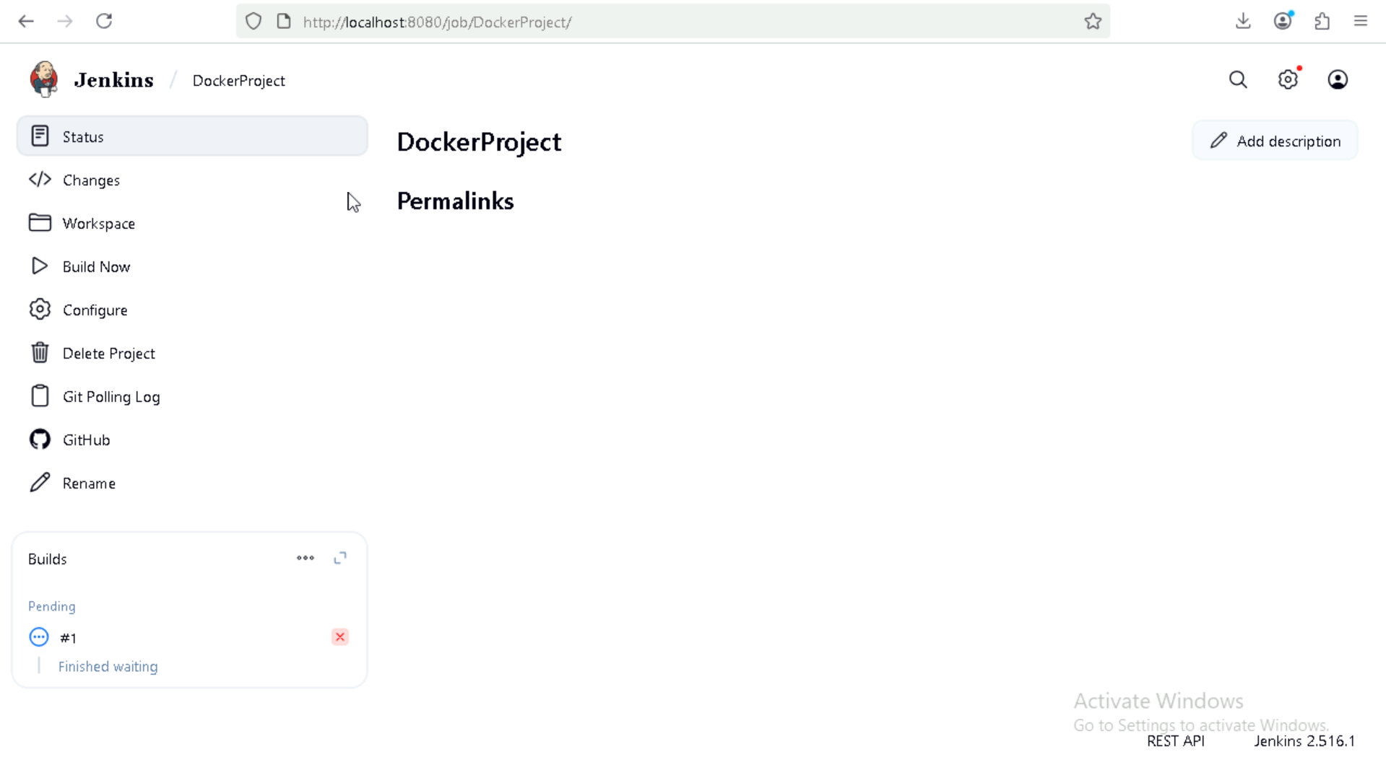
Create a Pipeline on Jenkins through git

Slide 10
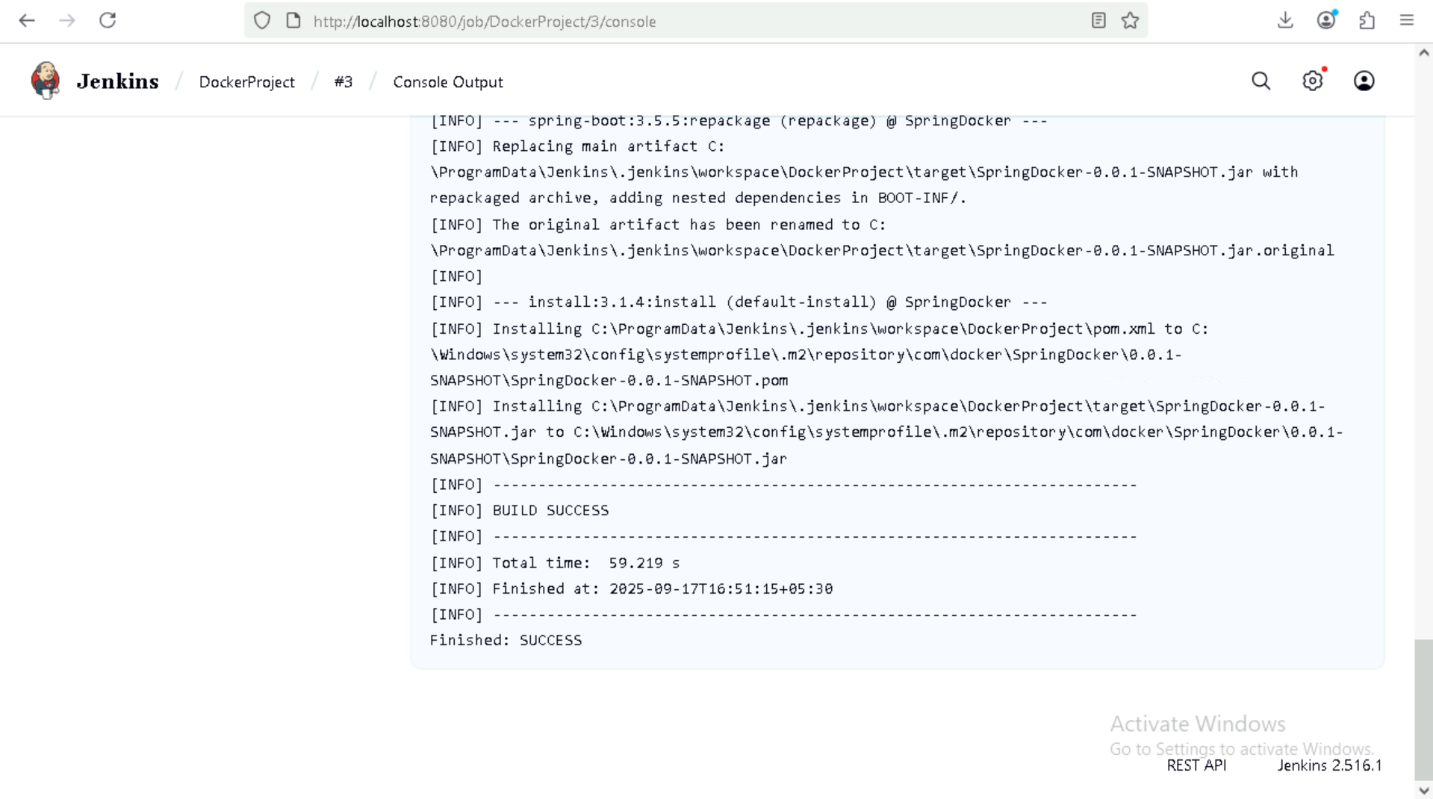
Build the project

Slide 11
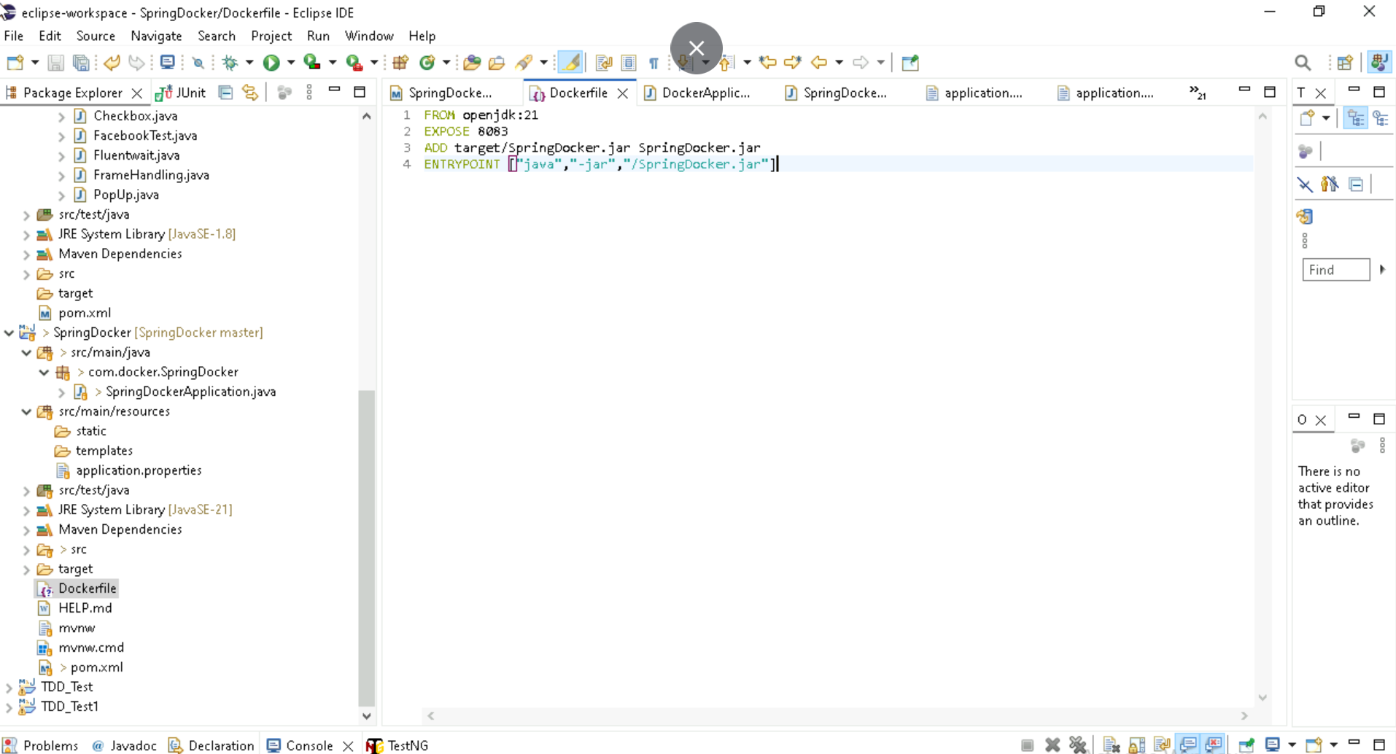
Create a Dockefile to track the project through docker

Slide 12
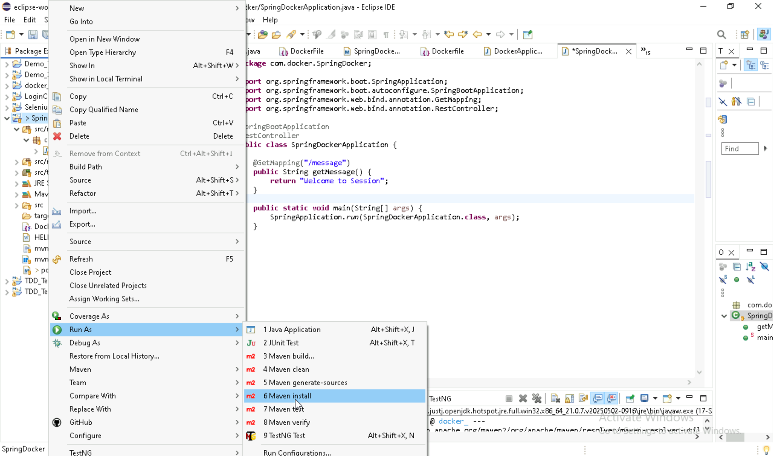
Do maven install to create jar file in target

Slide 13
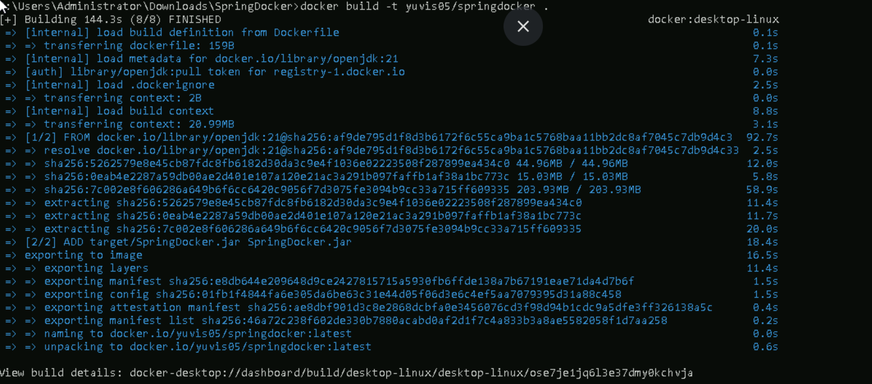
Build the Dockerfile to create Image

Slide 14
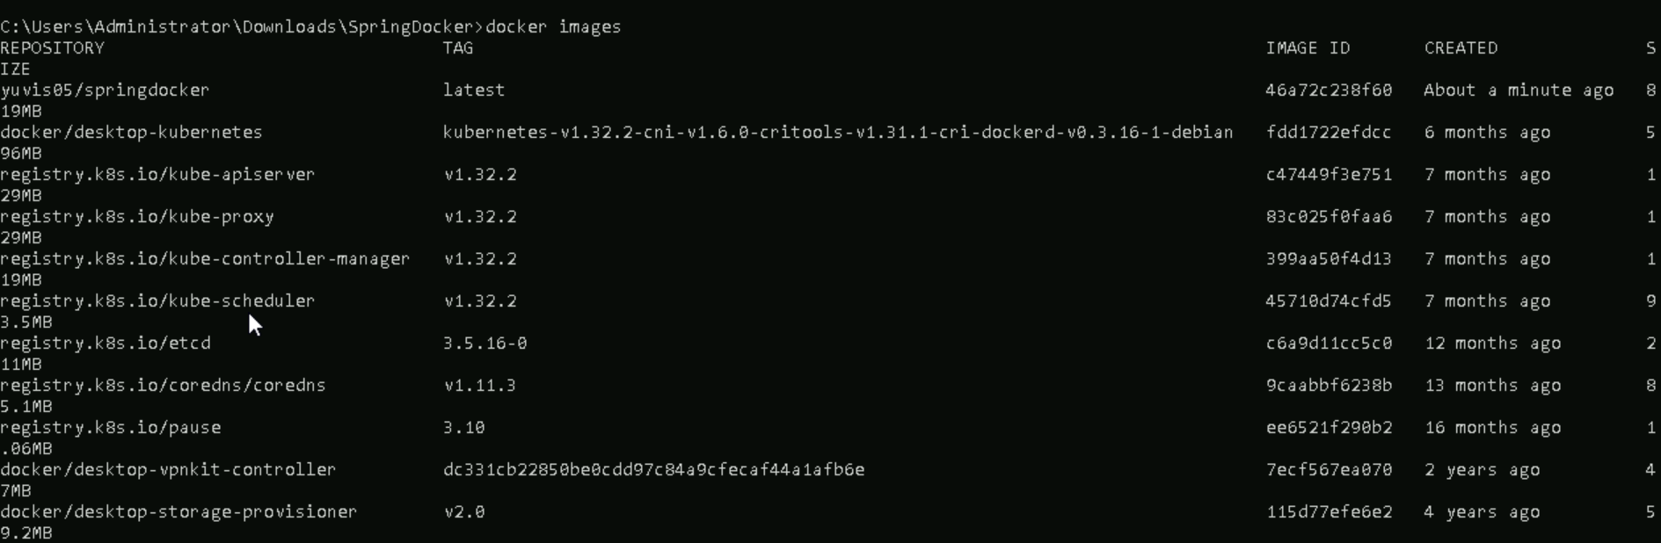
Check Image

Slide 15
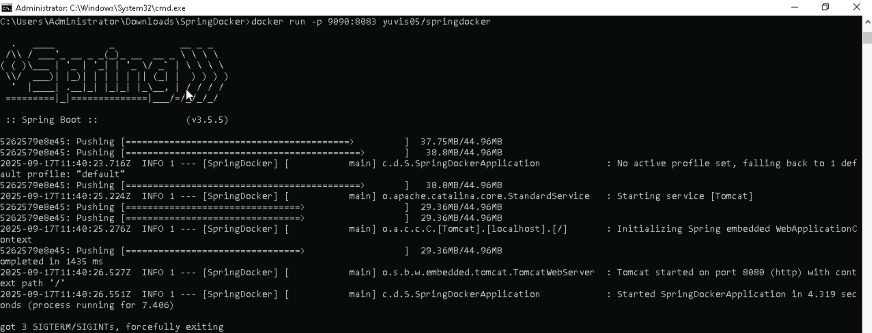
Create a Container from docker Image

Slide 16
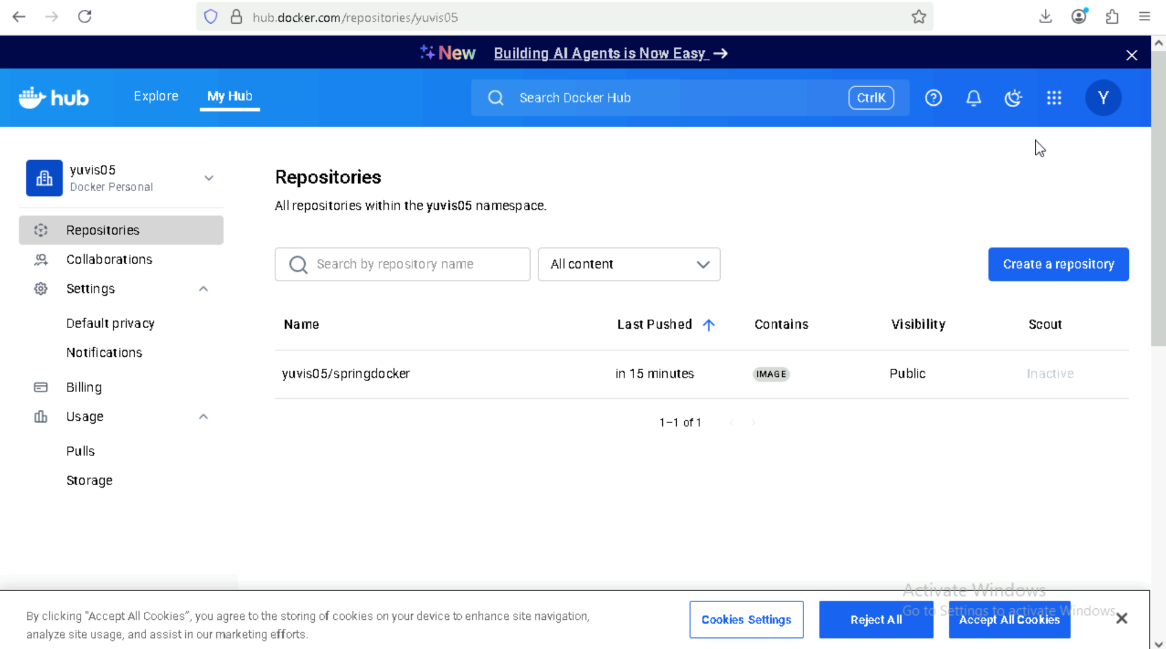
Image uploaded to docker hub

Slide 17

Company overview

Slide 18

Product overview
First beautifully designed product that's both stylish and functional

Slide 19
Problem
Market gap: few, if any, products on the market help customers like we do
Customers: 66% of US consumers spend money on multiple products that only partially resolves their issue
Financials: millennials account for about a quarter of the $48 billion spent on other products in 2018
Costs: loss of productivity costing consumers thousands of dollars
Usability: customers want something easy to use that helps make their life easier

Slide 20

Product benefits
Online store and market swap

Slide 21
Our competition
Our product is priced below that of other companies on the market
Design is simple and easy to use, compared to the complex designs of the competitors
Affordability is the main draw for our consumers to our product
Company A product is more expensive
Companies B & C product is expensive and inconvenient to use
Companies D & E product is affordable, but inconvenient to use

Slide 22
Product overview
Unique
First to market
Tested
Authentic
Only product specifically dedicated to this niche market
First beautifully designed product that's both stylish and functional
Conducted testing with college students in the area
Designed with the help and input of experts in the field

Slide 23
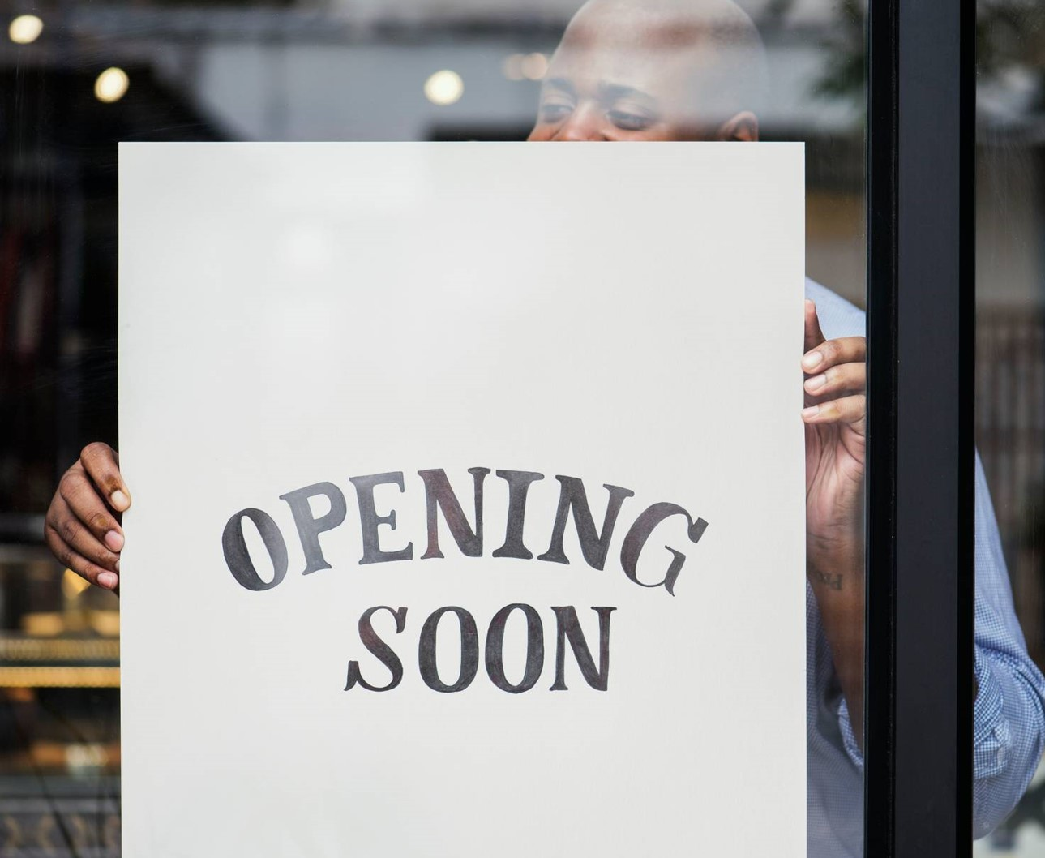
Growth strategy
Feb 20XX: roll out product to high profile or top-level participants to help establish the product
May 20XX: release the product to the public and monitor press release and social media accounts
Oct 20XX: gather feedback and adjust product design as necessary

Slide 24
Market overview
Opportunity to build
Fully inclusive market
Total addressable market
Freedom to invent
Selectively inclusive market
Serviceable available market
 | Clients | Orders | Gross revenue | Net revenue
20XX | 10 | 100 | $10,000 | $7,000
20XX | 20 | 200 | $20,000 | $16,000
20XX | 30 | 300 | $30,000 | $25,000
20XX | 40 | 400 | $40,000 | $30,000

Slide 25
Solution
Our product makes consumer lives easier, and no other product on the market offers the same features
Gen Z (18-25 years old)
Reduce expenses for replacement products
Simple design that gives customers the targeted information they need
Close the gap
Target audience
Cost savings
Easy to use

Slide 26
Financials
 | Year 1 | Year 2 | Year 3
Income
Users | 50,000 | 400,000 | 1,600,000
Sales | 500,000 | 4,000,000 | 16,000,000
Average price per sale | 75 | 80 | 90
Revenue @ 15% | 5,625,000 | 48,000,000 | 216,000,000
Gross profit | 5,625,000 | 48,000,000 | 216,000,000

Slide 27
Thank you
Brita Tamm
502-555-0152
brita@firstupconsultants.com
www.firstupconsultants.com

